Slide 1
Ideal Living x Walmart
WALMART SEARCH ADS
2025 Full Year Overview
Walmart Search | Brand vs Non-Brand Analysis
Full Year 2025

Slide 2
2025 YTD PERFORMANCE (Full Year)
2025 Performance and Review - Total
Metric | Brand | Non-Brand | Total | % Brand
Units | 1,099 | 1,075 | 2,174 | 50.6%
Revenue ($) | $131,718 | $104,388 | $236,106 | 55.8%
Ad Spend ($) | $13,202 | $79,536 | $92,738 | 14.2%
ROAS | $9.98 | $1.31 | $2.55 | -
Takeaways:
Total portfolio: 2,174 units, $236,106 revenue from $92,738 ad spend
Brand spend = 14% of total vs 86% Non-Brand
Brand ROAS ($9.98) significantly higher than Non-Brand ($1.31)
Brand campaigns drove 55.8% of total revenue, Non-Brand drove 44.2%

Slide 3
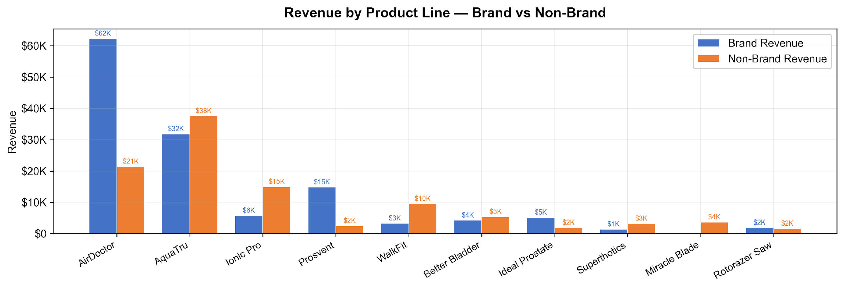
2025 YTD PERFORMANCE (Full Year)
2025 Performance - Brand vs Non-Brand by Product Line
Takeaways:
AirDoctor was the top revenue brand at $83,716
Several brands (Miracle Blade, Grown American) had nearly 100% Non-Brand revenue
AquaTru showed strong Non-Brand revenue, suggesting effective NB keyword targeting

Slide 4
2025 YTD PERFORMANCE (Full Year)
2025 Performance - Brand vs Non-Brand Detail
Branded
Non-Branded
Brand | Units | Revenue | Ad Spend
AirDoctor | 288 | $62,278 | $5,391
AquaTru | 239 | $31,798 | $2,016
Prosvent | 168 | $14,837 | $4,318
Ionic Pro | 29 | $5,767 | $169.54
Ideal Prostate | 80 | $5,153 | $493.95
Better Bladder | 75 | $4,271 | $293.20
WalkFit | 121 | $3,296 | $201.37
Rotorazer Saw | 15 | $1,907 | $84.89
Brand | Units | Revenue | Ad Spend
AquaTru | 250 | $37,570 | $15,525
AirDoctor | 53 | $21,439 | $30,055
Ionic Pro | 87 | $14,989 | $4,066
WalkFit | 253 | $9,541 | $5,878
Better Bladder | 99 | $5,402 | $5,782
Miracle Blade | 120 | $3,685 | $3,860
Superthotics | 68 | $3,185 | $3,199
Prosvent | 39 | $2,491 | $3,066
Takeaways:
Brand campaigns spent only $13,202 (14%) but generated $131,718 revenue (56%)
Non-Brand spent $79,536 (86%) generating $104,388 revenue (44%)
Brand ROAS $9.98 vs NB ROAS $1.31 — 7.6x difference

Slide 5
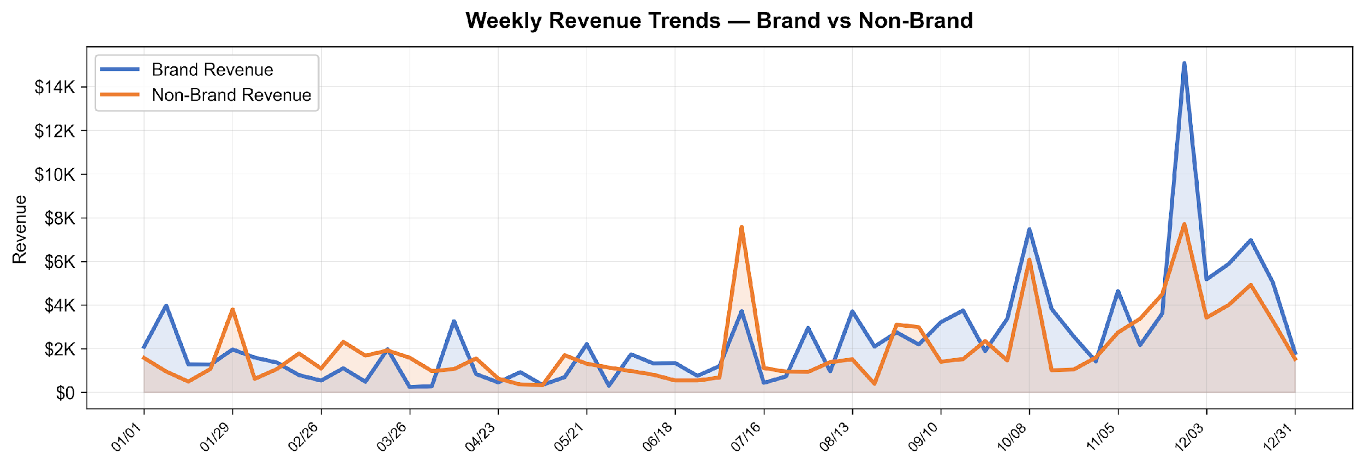
2025 YTD PERFORMANCE (Full Year)
2025 Weekly Trends - Revenue
Takeaways:
Peak total revenue week: 11/26 at $22,804
Brand revenue spiked in late November (BFCM) reaching $15,092
Strong Q4 seasonality across both Brand and Non-Brand

Slide 6
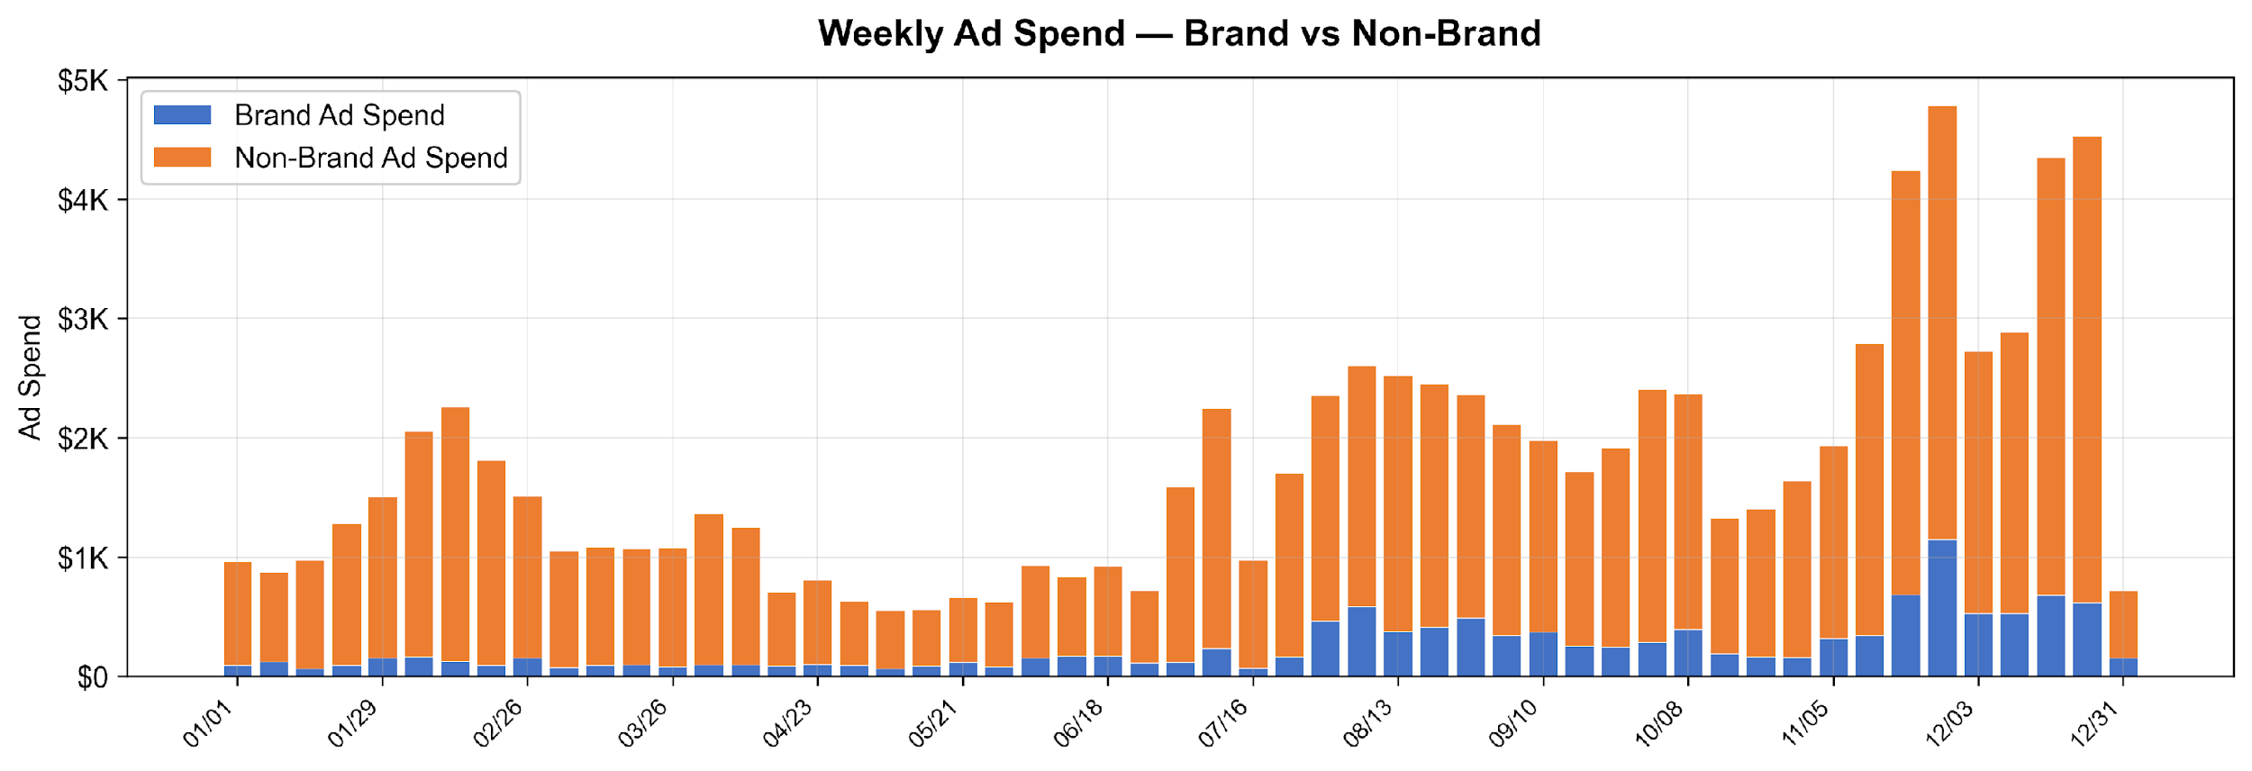
2025 YTD PERFORMANCE (Full Year)
2025 Weekly Trends - Ad Spend
Takeaways:
Avg weekly Brand spend $249.09 vs NB $1,501
Non-Brand consistently ~86% of total spend
Peak week spend: $4,784

Slide 7
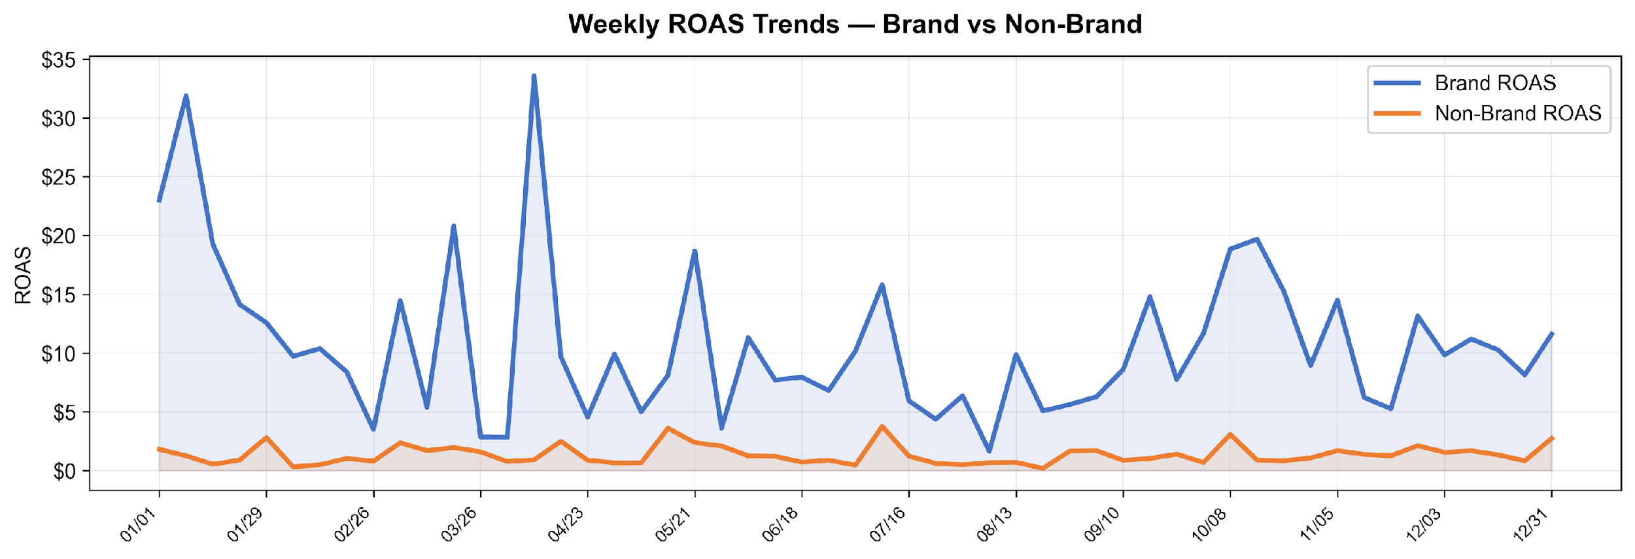
2025 YTD PERFORMANCE (Full Year)
2025 Weekly Trends - ROAS
Takeaways:
Avg weekly Brand ROAS $10.81 vs NB $1.36
Brand ROAS volatile: $1.64 to $33.61
Non-Brand ROAS more consistent, typically $1-$5 range

Slide 8
2025 YTD PERFORMANCE (Full Year)
2025 Revenue Distribution by Brand
Revenue by Brand
Ad Spend by Brand
Takeaways:
AirDoctor largest revenue share and highest NB ad spend
AquaTru and Ionic Pro showed strong NB revenue returns relative to spend

Slide 9
2025 YTD PERFORMANCE (Full Year)
2026 Recommendations:
Brand Campaign Optimization
Continue investing in branded campaigns given higher ROAS ($9.98 vs $1.31 NB)
Expand branded keyword coverage for underrepresented brands
Non-Brand Efficiency
Review NB campaigns with negative ROAS and optimize or pause underperformers
Focus NB spend on top performers: AquaTru, Ionic Pro, WalkFit
Seasonal Strategy
Plan increased Q4 budgets given strong holiday performance
Build campaign structures earlier in Q3 for pre-holiday demand
Portfolio Expansion
Apply successful strategies from AirDoctor/AquaTru to smaller brands
Test new match types and campaign structures for mid-tier brands

Slide 10
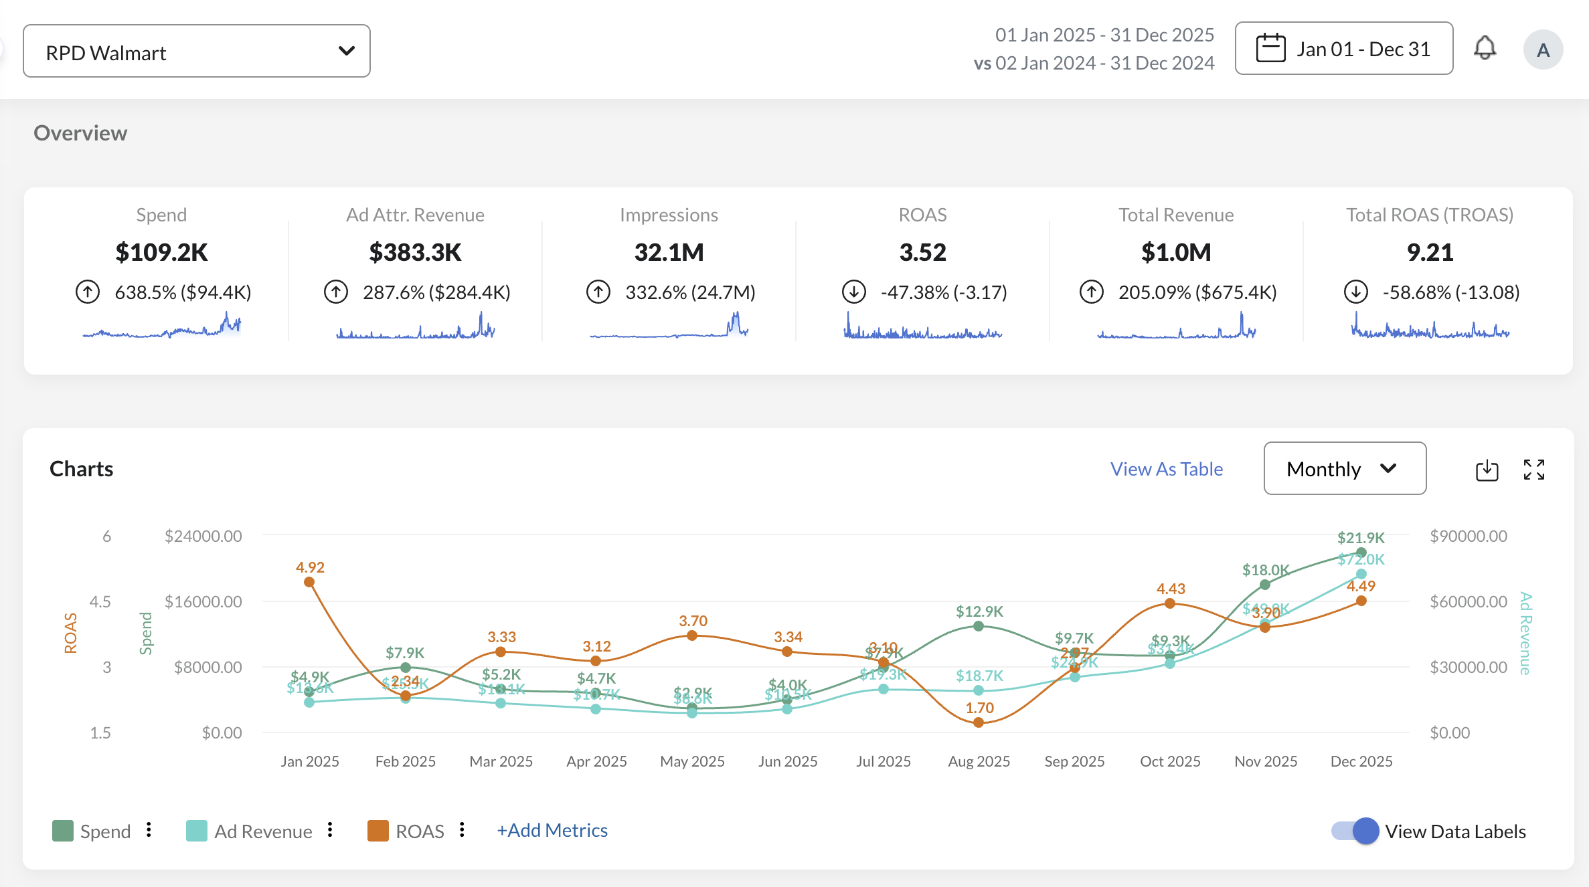
2025 YTD PERFORMANCE (Full Year)
2025 Walmart Overview - Spend, Revenue & ROAS

Slide 11
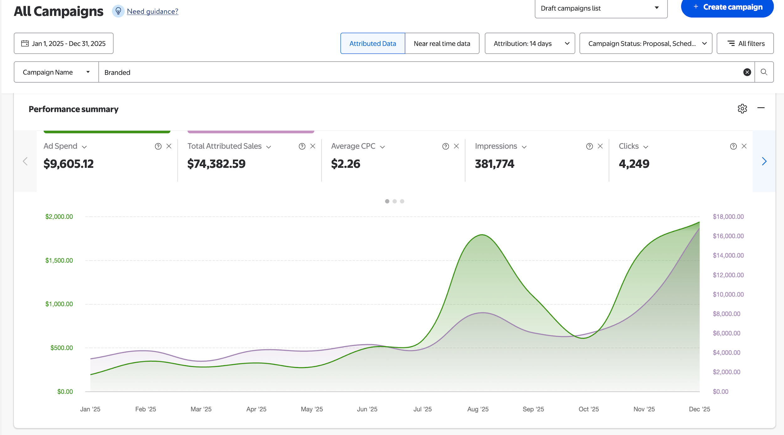
2025 YTD PERFORMANCE (Full Year)
2025 Branded Campaigns - Performance Summary

Slide 12
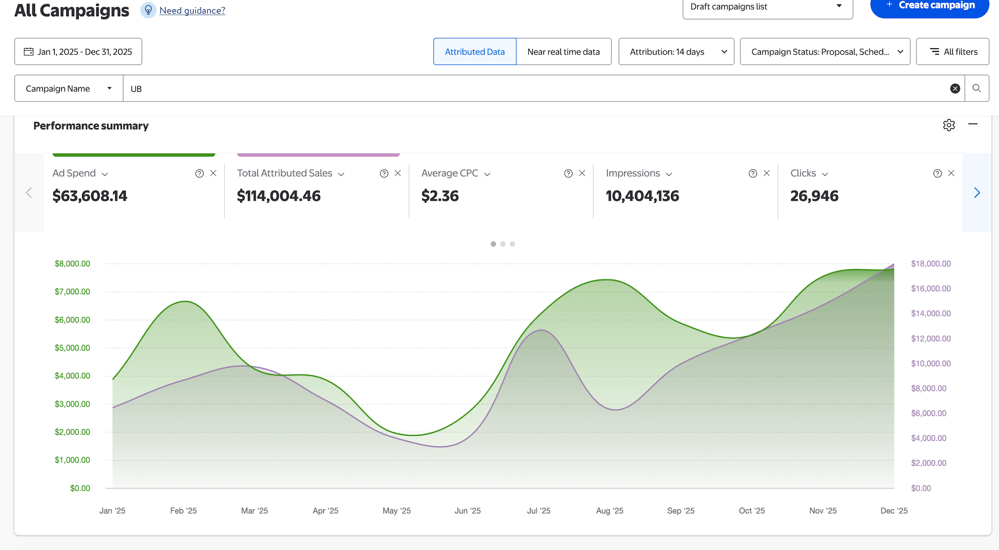
2025 YTD PERFORMANCE (Full Year)
2025 Non-Branded Campaigns - Performance Summary

Slide 13
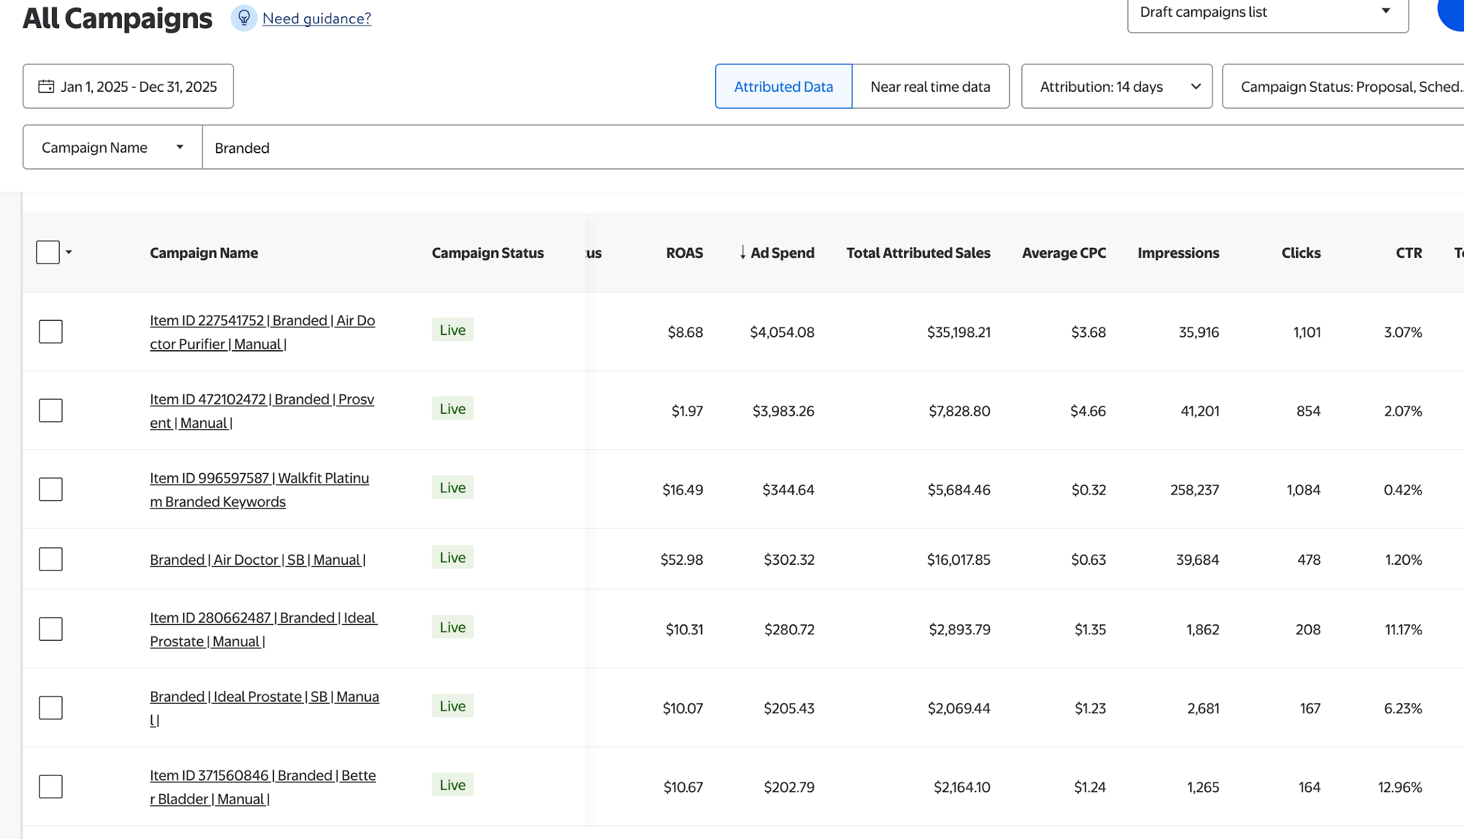
2025 YTD PERFORMANCE (Full Year)
2025 Branded - Top Campaigns

Slide 14
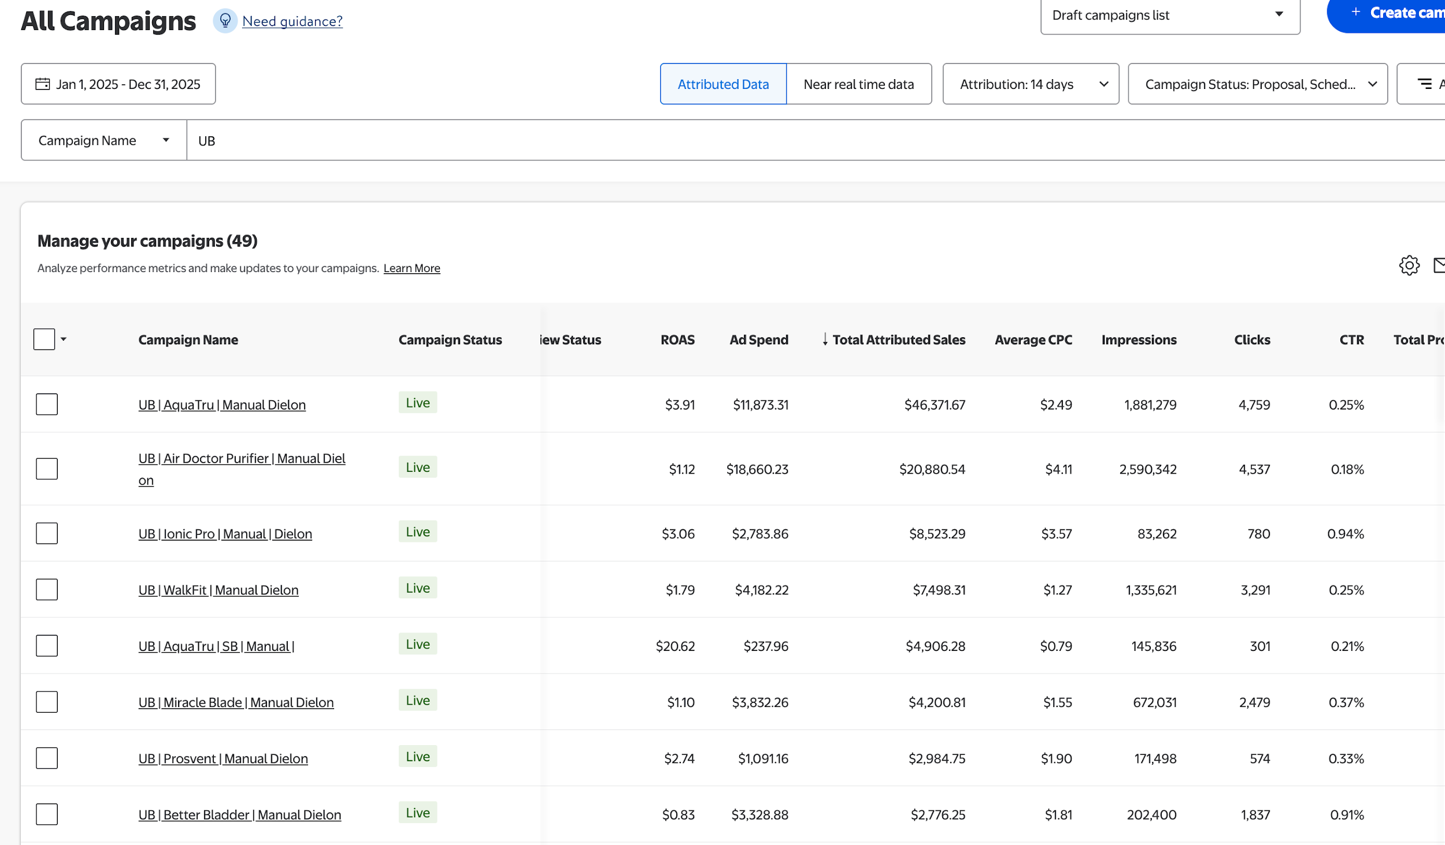
2025 YTD PERFORMANCE (Full Year)
2025 Non-Branded - Top Campaigns

